Slide 1
Presentation on Traffic Sign Classification using Deep-Learning By Aditya Sangle –C- 17u463-313005 Nagarjuna Vatti –C- 17u340- 313023 Shreyas Kulkarni –B- 17u232- 312060 Rutuparn Pawar –B- 17u253- 312052 Subject : Machine Learning (Value added Course)
Guided by
Dr. A.V.Bang
Department of Electronics and Telecommunications
Vishwakarma Institute of Information Technology,Pune

Slide 2
Outline
Introduction
Motivation
Literature Survey
Objectives
Methodology
Dataset
Implementation
Different Phases of Implementation (if any)
Results
Conclusions
References

Slide 3
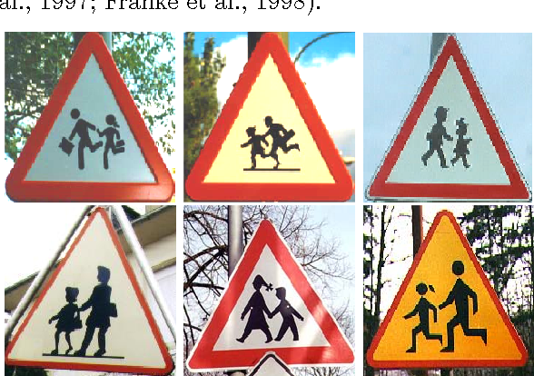
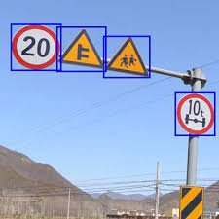
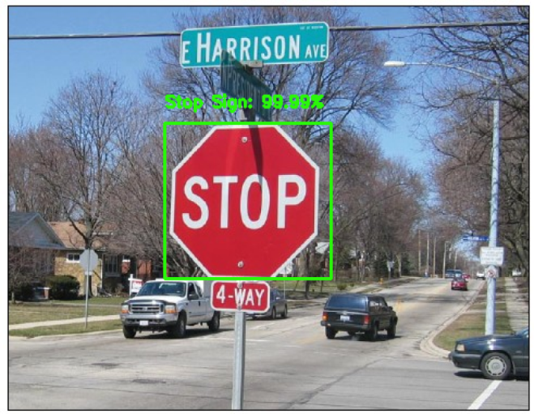
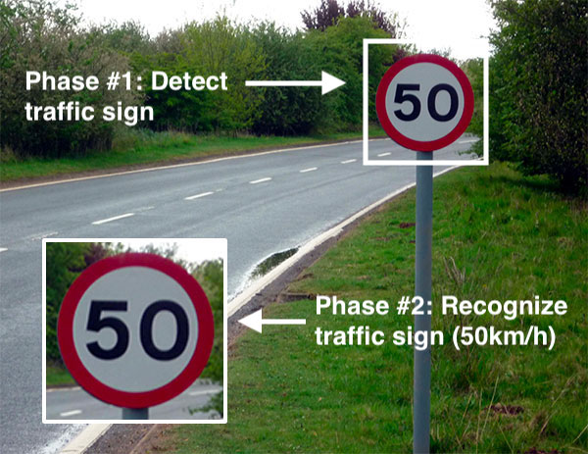
INTRODUCTION
Traffic Sign Detection and
Classification using Deep-Learning’s
Covolutional Neural Network Architecture.

Slide 4
INTRODUCTION
We have trained a deep learning model using 51839 traffic signs images dataset.
We have created a GUI using Tkinter.
We are using openCV library for real time computer vision.
This computer vision we have interfaced with Arduino uno.
We have developed a CNN model having training accuracy of 98.69% and test accuracy = 99.53%.
A hardware model is also implemented using the deep learning .

Slide 5
Motivation
Traffic signs are an integral part of our road infrastructure. They provide critical information, sometimes compelling recommendations, for road users, which in turn requires them to adjust their driving behaviour to make sure they adhere with whatever road regulation currently enforced.
Without such useful signs, we would most likely be faced with more accidents, as drivers would not be given critical feedback on how fast they could safely go, or informed about road works, sharp turn, or school crossings ahead.
In our modern age, around 1.3M people die on roads each year. This number would be much higher without our road signs.Naturally, autonomous vehicles must also abide by road legislation and therefore recognize and understand traffic signs.

Slide 6
Literature Survey
Data debiased traffic sign recognition using MSERs and CNN.
In this paper CheolyongJang ; Hyoungrae Kim et al proposed a traffic sign recognition algorithm which is unaffected by dataset bias.
Traffic Sign Detection and Recognition Based on Convolutional Neural Network
This paper brings forward a traffic sign recognition technique on the strength of deep learning, which mainly aims at the detection and classification of circular signs.

Slide 7
Literature Survey
Lightweight Traffic Sign Recognition Algorithm based on Cascaded CNN
In this paper, the authors collected Traffic signs in South Korea and we proposed a light-weight traffic sign recognition (TSR) algorithm based on cascaded CNN
Real-time Traffic Sign Recognition system with deep convolutional neural network.
In this paper, 6 types of traffic sign images are trained by LeNet-5 convolutional neural network architecture.

Slide 8
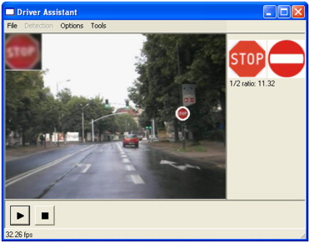
Objectives or Aim and Objectives
Aim :- To build a Deep Learning model which will detect and classify traffic signs accordingly.
Objective :- 1) Identifying the sign and classifying it.
2) To interface the model with GUI and hardware.

Slide 9
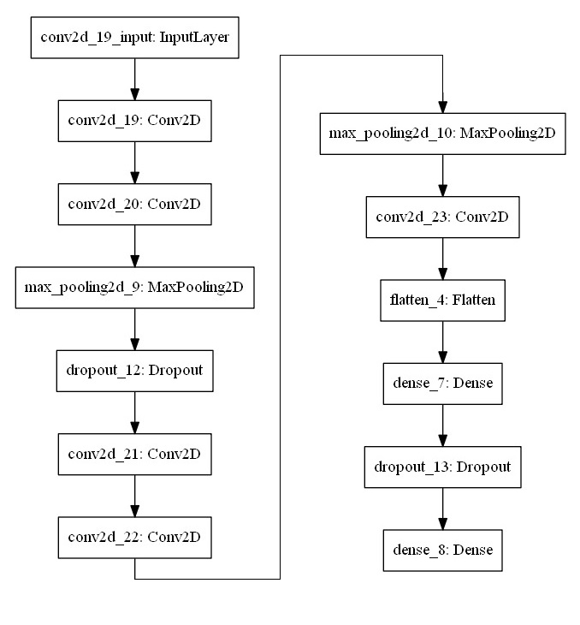
METHODOLOGY

Slide 10
SOFTWARE, LIBRARIES AND HARDWARE
Softwares: PyCharm ,Juypter Notebook and Arduino IDE.
Libraries : Tensorflow, Keras, Pandas, Matlplotlib, OS, PIL, Open CV, Serial, Python txt to speech, Tkinter .
Developed a ‘User Interface(UI)’ using Tkinter library which asks user to upload a traffic sign and classifies it among 43 classes.
Also developed a small car using arduino ,who’s movement is controlled according to the traffic sign detected by the camera.

Slide 11
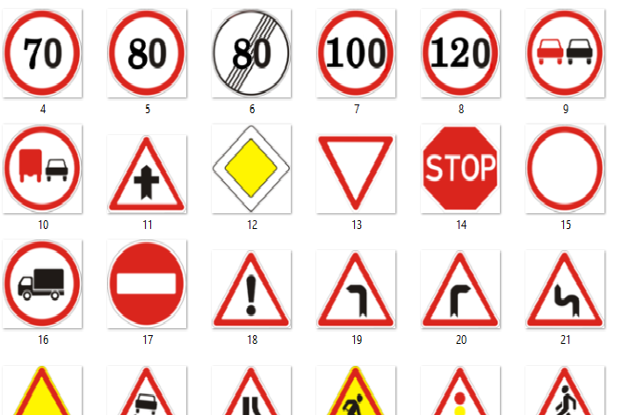
Dataset used
The ‘gtsrb-german-traffic-sign’ is a open source dataset ,available on Kaggel.
The dataset consists of total 43 classes representing 43 traffic signs.
The dataset contains 51839 samples of which 39209 are used for training and remaining 12630 are used for testing.
Traffic Sign Classification

Slide 12
Different Phases of Implementation
Bulding a Deep Learning model with Convolutional Neural Network(CNN) Architecture.
Building a GUI(Tkinter) to interface the model and a OpenCv architecture for real time detection and classification
Interfacing hardware(Arduino) with developed model ,to perform real time classification and execution.

Slide 13
Trained Models and Results
No. of Convolutional Layers | Optimizer | Epochs | Training Loss | Training Accuracy | Validation Loss | Validation Accuracy
4 | Adam | 15 | 0.0939 | 0.9940 | .1212 | 0.9590
5 | Adam | 20 | 0.0477 | 0.9869 | 0.0185 | 0.9953
4 | Adam | 20 | 0.281 | 0.9248 | 0.1062 | 0.9703
5 | Adagrad | 15 | 0.6569 | 0.8284 | 0.2884 | 0.9454
5 | SGD | 15 | 0.1953 | 0.9515 | 0.0559 | 0.9885

Slide 14
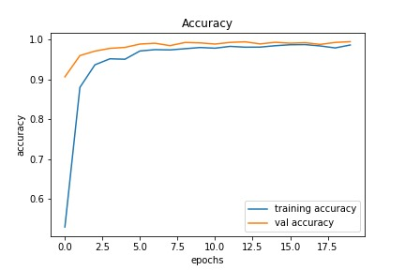
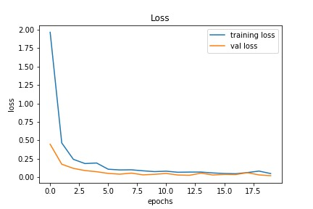
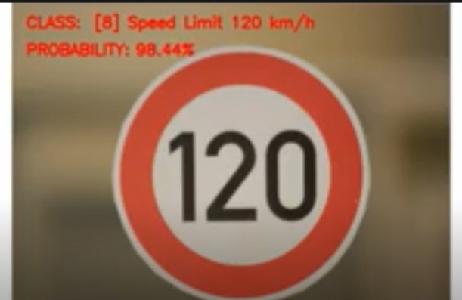
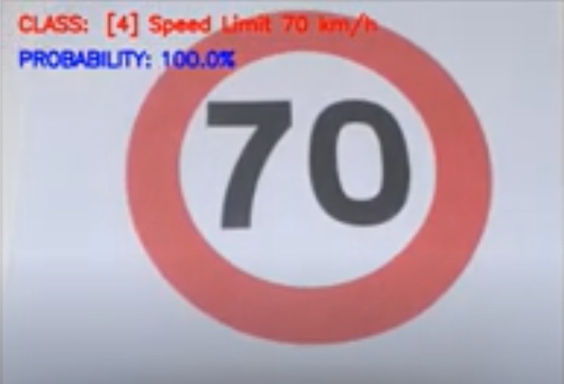
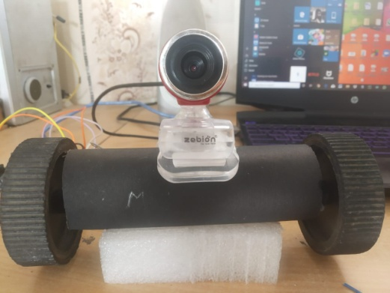
Results : Plots and GUI output

Slide 15
Conclusion
We successfully have built a deep learning model to classify traffic signs with 98.7% accuracy on train data and 99.53% accuracy on test data, employing a variety of pre-processing and regularization techniques(e.g. dropout) and trying different model architectures.
We thoroughly enjoyed this project and gained practical experience using Tensorflow, Keras matplotlib and investigating artificial neural network architectures.
In the future, We believe higher accuracy can be achieved by applying further regularization techniques such as batch normalization and also by adopting more modern architecture such as GoogleNet’s Inception Module, ResNet or Xception.

Slide 16
References
Saad Albawi,Tarek Abed Mohammed and Saad-Al-Zawi “Understanding of a convolutional neural network” 2017.
Neena Aloysius and M Geeta “A review on deep convolutional neural networks” IEEE 2017.

Slide 17
Reference Books
Hands-On Machine Learning with Scikit-Learn, Keras, and TensorFlow, 2nd Edition by Aurélien Géron.Released September 2019.Publisher(s): O'Reilly Media, Inc.
ISBN: 9781492032649
Fundamentals of Deep Learning ,by Nikhil Baduma , Nicholas Locascio. Publisher(s): O'Reilly Media, Inc.
ISBN: 9781491925614

Slide 18
Questions Please ??? THANK- YOU

